Slide 1

A Little Lean with Kanban
Introduction
What is it?
What Problem?
Why Kanban
How
Benefits
What is Kanban
What Problem Are We Solving?
How do we do it?
Introduction
Why Kanban?
Benefits of Kanban
Tim Wingfield
Email: tim@timwingfield.com
Blog: blog.timwingfield.com
Twitter: timwingfield

Slide 2
Introduction
pptPlex Section Divider
The slides after this divider will be grouped into a section and given the label you type above. Feel free to move this slide to any position in the deck.

Slide 3
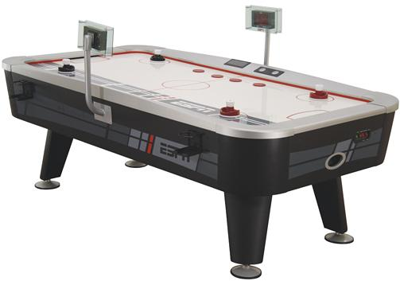

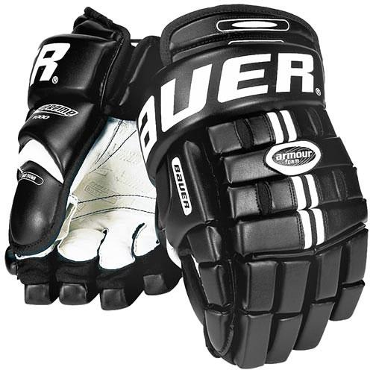

Slide 4
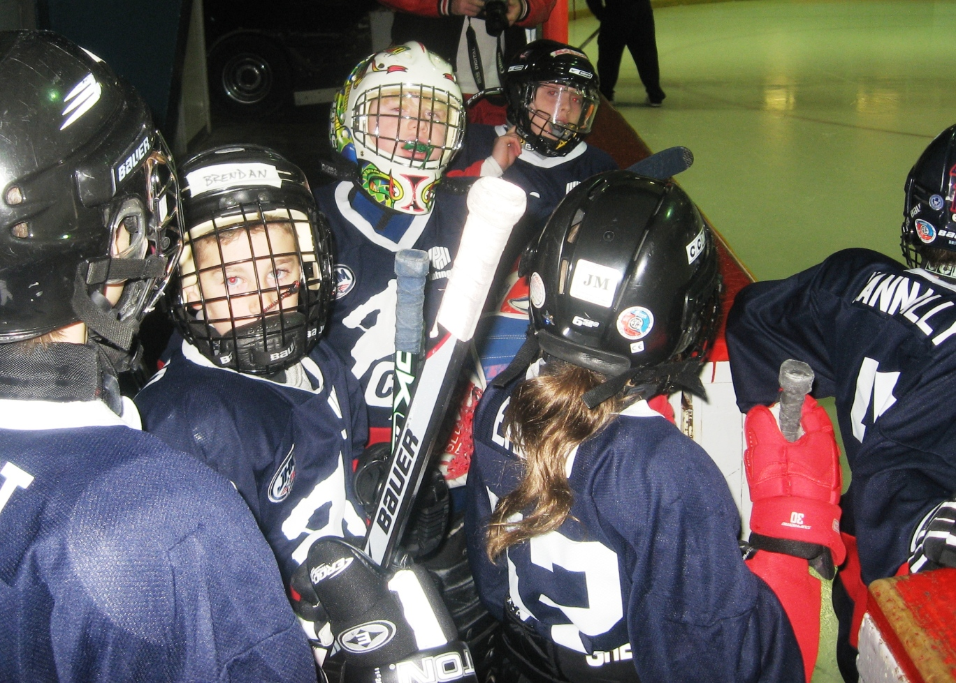

Slide 5
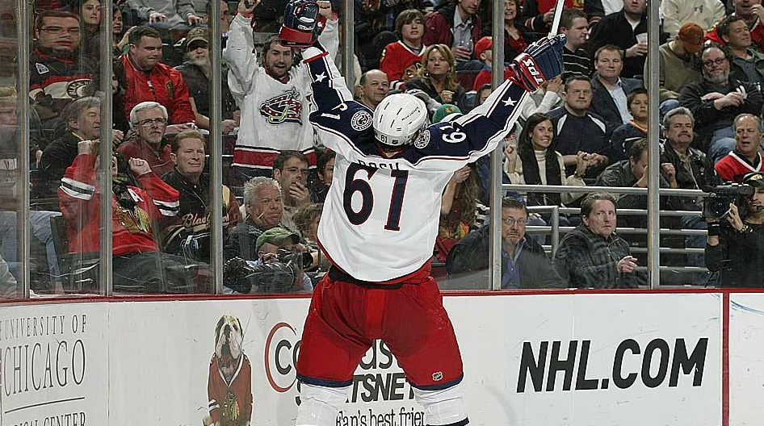
Notes:
Love hockey, especially this guy…pay a lot to see him, at least.

Slide 6



vs
Tonight at 6PM
Live from Joe Louis Arena

Slide 7



Notes:
Professionally, I work for Quick Solutions, even though none of these people do.
Been with Quick for five years, all in the App Dev Group started by BHP.
Been developing for over 10 years, all in Columbus.

Slide 8
What is Kanban
pptPlex Section Divider
The slides after this divider will be grouped into a section and given the label you type above. Feel free to move this slide to any position in the deck.

Slide 9


Kanban
Notes:
Roughly translates to Card and Signal
Also heard it as “sign”
Japanese term

Slide 10

Notes:
Part of Lean Manufacturing
Started with the Toyota Production System, brought to software by Mary and Tom Poppendieck through their work at 3M
Two books, second one seems to be the one recommended the most: Implementing Lean Software Development
Books: Toyota Production System, and the Toyota Way
7 principles of Lean Software Dev
Eliminate Waste
Build Quality in
Create Knowledge
Defer Commitment
Deliver Fast
Respect People
Optimize the Whole

Slide 11
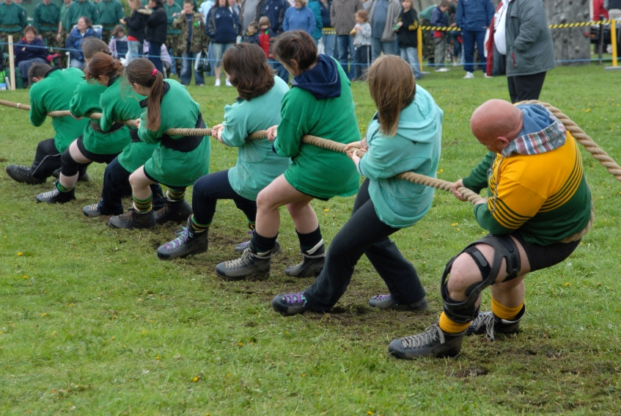
Notes:
Production determined by actual demand
If a bucket is full, can’t push more into it – from inventory in manufacturing

Slide 12
What Problem Are We Solving?
pptPlex Section Divider
The slides after this divider will be grouped into a section and given the label you type above. Feel free to move this slide to any position in the deck.

Slide 13
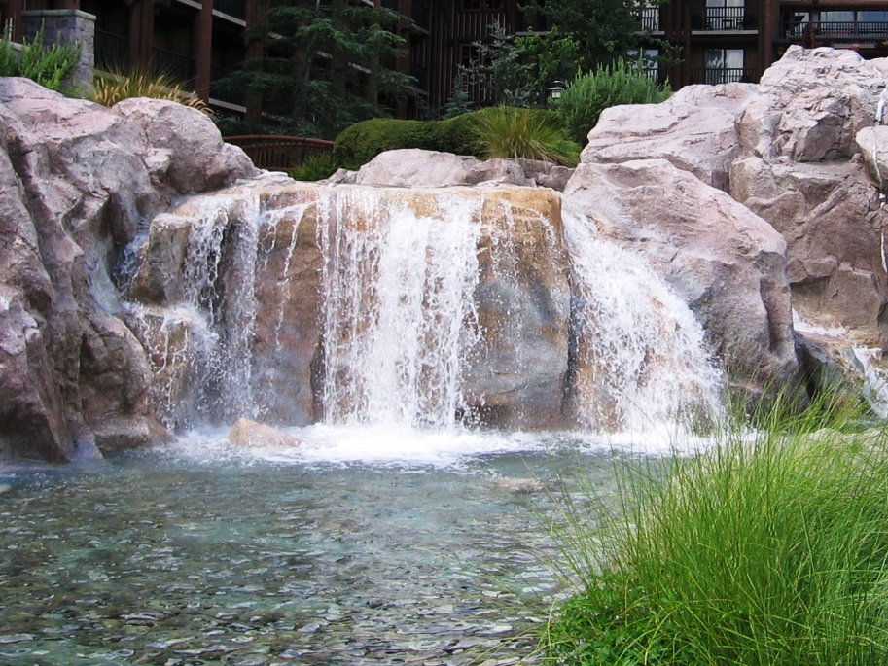
Notes:
Long Feedback Loop
Testing well after development puts devs at a disadvantage due to their natural ADD
Scrum addresses to the iteration, 1 or 2 weeks

Slide 14

Iteration Driven Design
Calendar picture
Notes:
Iteration Driven Design
IDD – Scrum gone bad
Crank out dev in two week cycles, what about testing? Same 2 weeks?

Slide 15
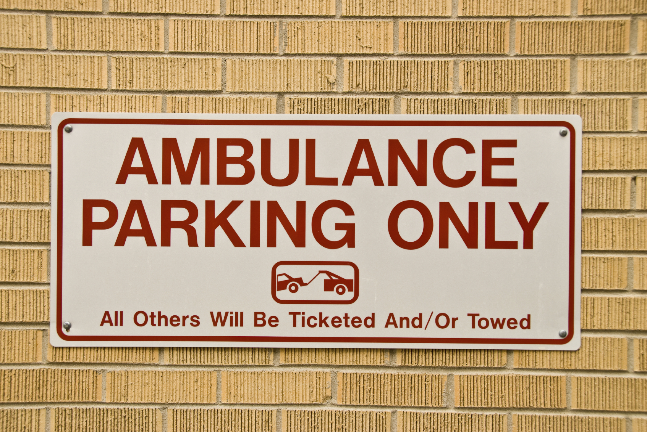
No Prioritization
Ambulance parking
Notes:
No Prioritization
No priority set
Constant priority switching
Huge back log of all high priority items
THRASHING

Slide 16
Why Kanban?
pptPlex Section Divider
The slides after this divider will be grouped into a section and given the label you type above. Feel free to move this slide to any position in the deck.

Slide 17
Notes:
Reduce Work-in-Progress
Reduce multi-tasking
Reduce backlog to workable size

Slide 18

Notes:
Balance Capacity against demand
Match work to team
Give realistic expectations

Slide 19

Notes:
Prioritize
“Disney Queue”
The Never Bin

Slide 20
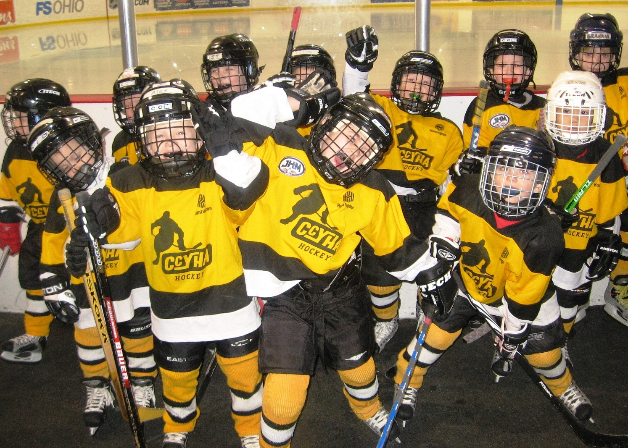
Focus on team
Notes:
Focus on the team
Team decreases cycle time and thru-put
Team works items through the queue together (Queue Limits)

Slide 21
How do we do it?
pptPlex Section Divider
The slides after this divider will be grouped into a section and given the label you type above. Feel free to move this slide to any position in the deck.

Slide 22

Notes:
Determine your process
Question yourself
Deeper level would be value stream mapping
High level determine -> dev, test, qa, backlog, blocked, etc

Slide 23
Not Started
In Process
Done
Notes:
Scrumban – Corey Ladas
Simple first step

Slide 24
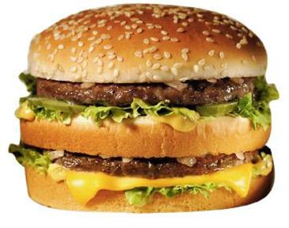
Minimal Marketable Feature (MMF)
Notes:
One Piece Flow
Minimal Marketable Feature

Slide 25
Big Mac Tasks
Lettuce
Special Sauce
2 All Beef
Patties
Pickles
Cheese
Onions
Sesame Seed Bun
Notes:
Steps of a big mac
Fry the two all beef patties
Get the sesame seed bun
Add the lettuce and pickles to sesame seed bun
Add the now fried two all beef patties
Put cheese on the two all beef patties
Blat on the special sauce
Sprinkle on Onions
Assemble sections
DONE!

Slide 26
Hold for
Assembly
Not Started
In Process
Done
Sesame Seed Bun
Cheese
2 All Beef
Patties
Lettuce
Pickles
Special Sauce
Onions

Slide 27
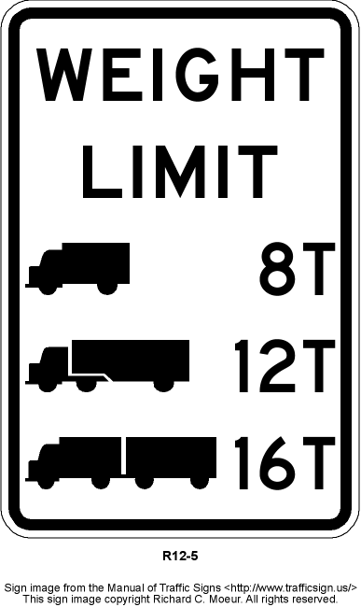
Notes:
Queue limits or WIP Limits
Queue limits for Big Mac example – 1 fry cook can make 6 patties, bun guy can only get two sets of buns ready at a time. Max Big Mac in process is therefore 2.
Queue limits for Flitter – size of team, tasks each member has to do, determine capacity
Can’t add to WIP then swarm a feature, help in a different capacity, reduce a bottleneck

Slide 28
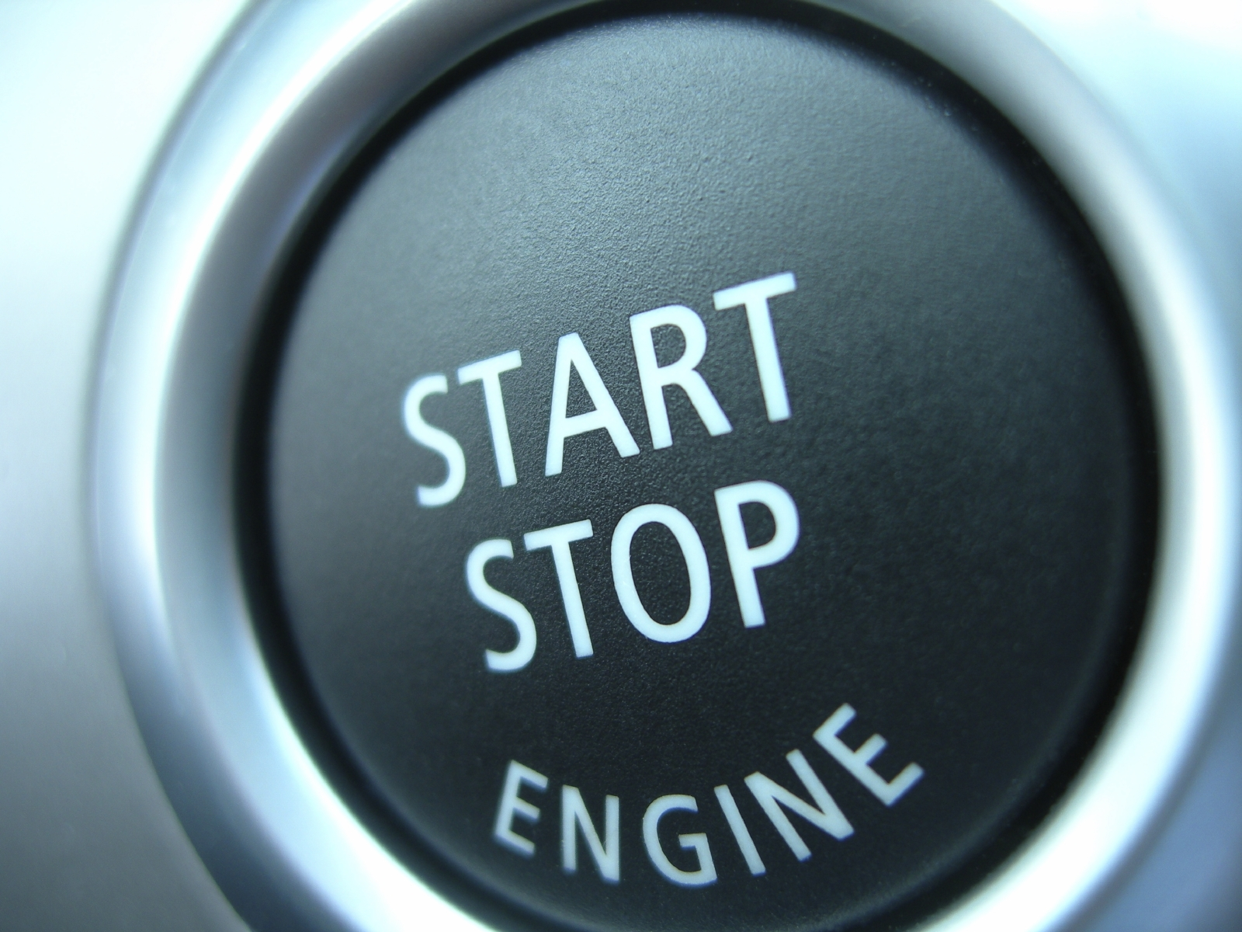
Trigger Points
Stop start engine
Notes:
Trigger points
When an item in a bucket triggers another move
Big Mac – Patties on the buns will trigger adding the cheese, then assembly
Flitter – Two items in the Dev Complete will trigger testing to start on one of them

Slide 29
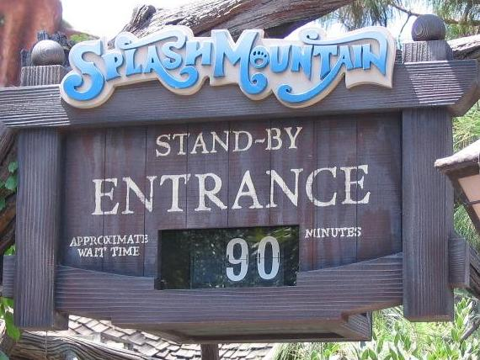
Cycle Time
“Minutes from this point” picture
Notes:
Cycle Time – “Disney Line Planning”
Time to complete work in progress: From dev through demo
Keep it balanced: don’t want 2 day dev cycle time and a 6 day testing cycle time. Need to cut down bottleneck at test point
Goal is to decrease cycle time. Gain cadence, reduce waste
Different cycles for different MMFs possible. May want a S, M, L cycle estimate per MMF

Slide 30
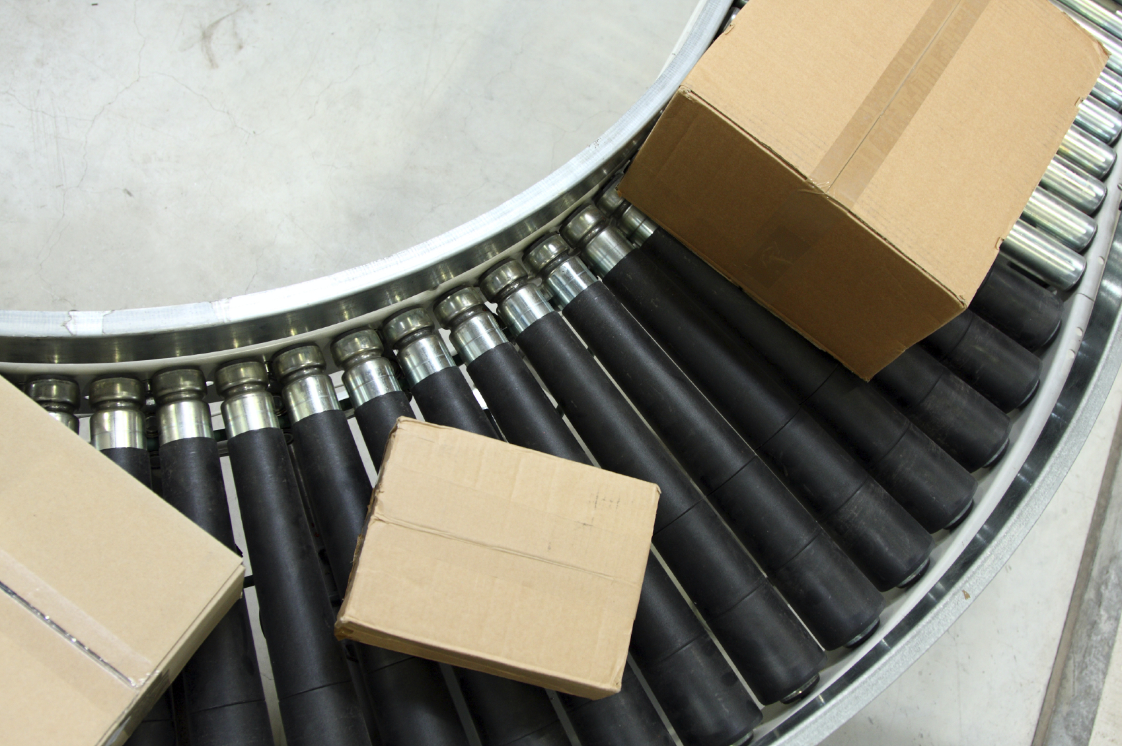
Throughput
Boxes on conveyor
Notes:
Throughput
Output over a given time
WIP/Cycle time
Allows forecasting

Slide 31
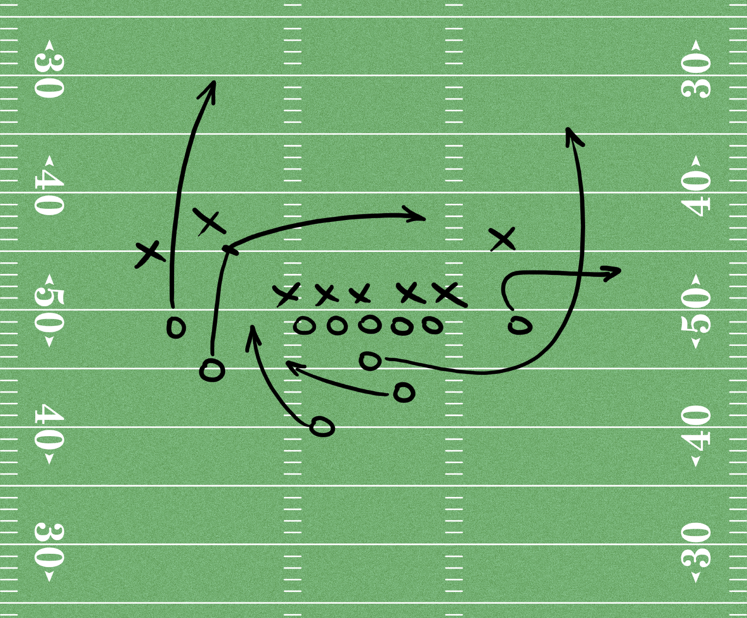
Incremental planning
Football play
Notes:
Incremental planning…breakout the MMF as it goes into the backlog
Decouple planning, dev, review, and release – Each can have its own cadence
Plan for it as you need it, when you need it
Leads to Late binding tasks -> Assign to the dev with the capacity at the time the task goes into WIP
Relies on the team aspect, utilize the team capacity, not just the individuals

Slide 32
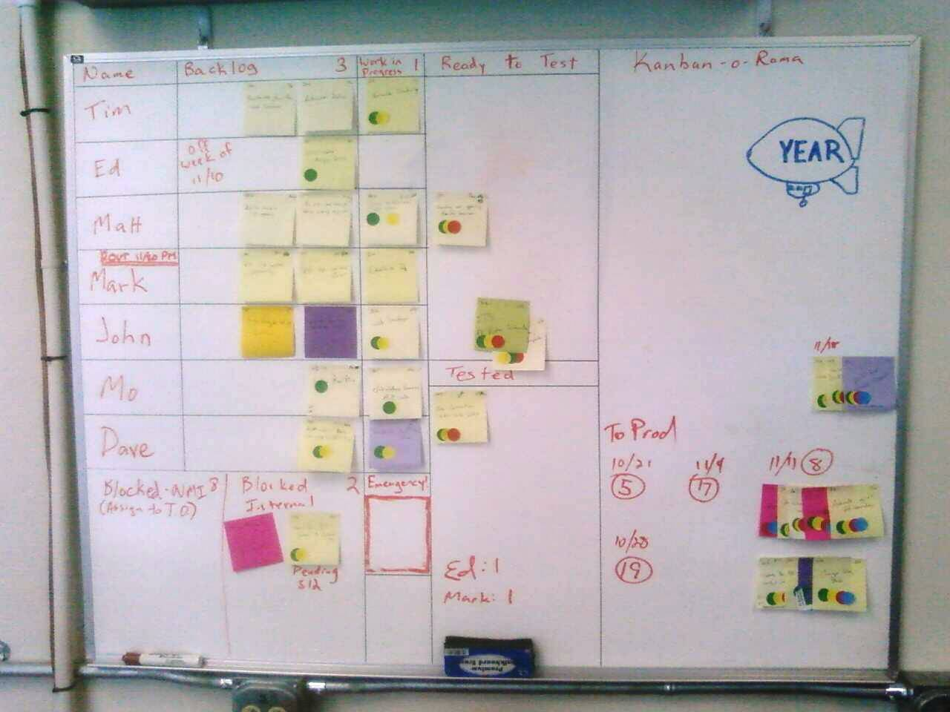
RL Board
(Sample Section)
Notes:
RL Sample board
Maintenance situation
Tried Scrummish approach with iterations, etc. Didn’t work out as tickets piled up, and focus was constantly changing
Cycle time varied from a few hours to a few days per ticket – not all tickets are created equal

Slide 33
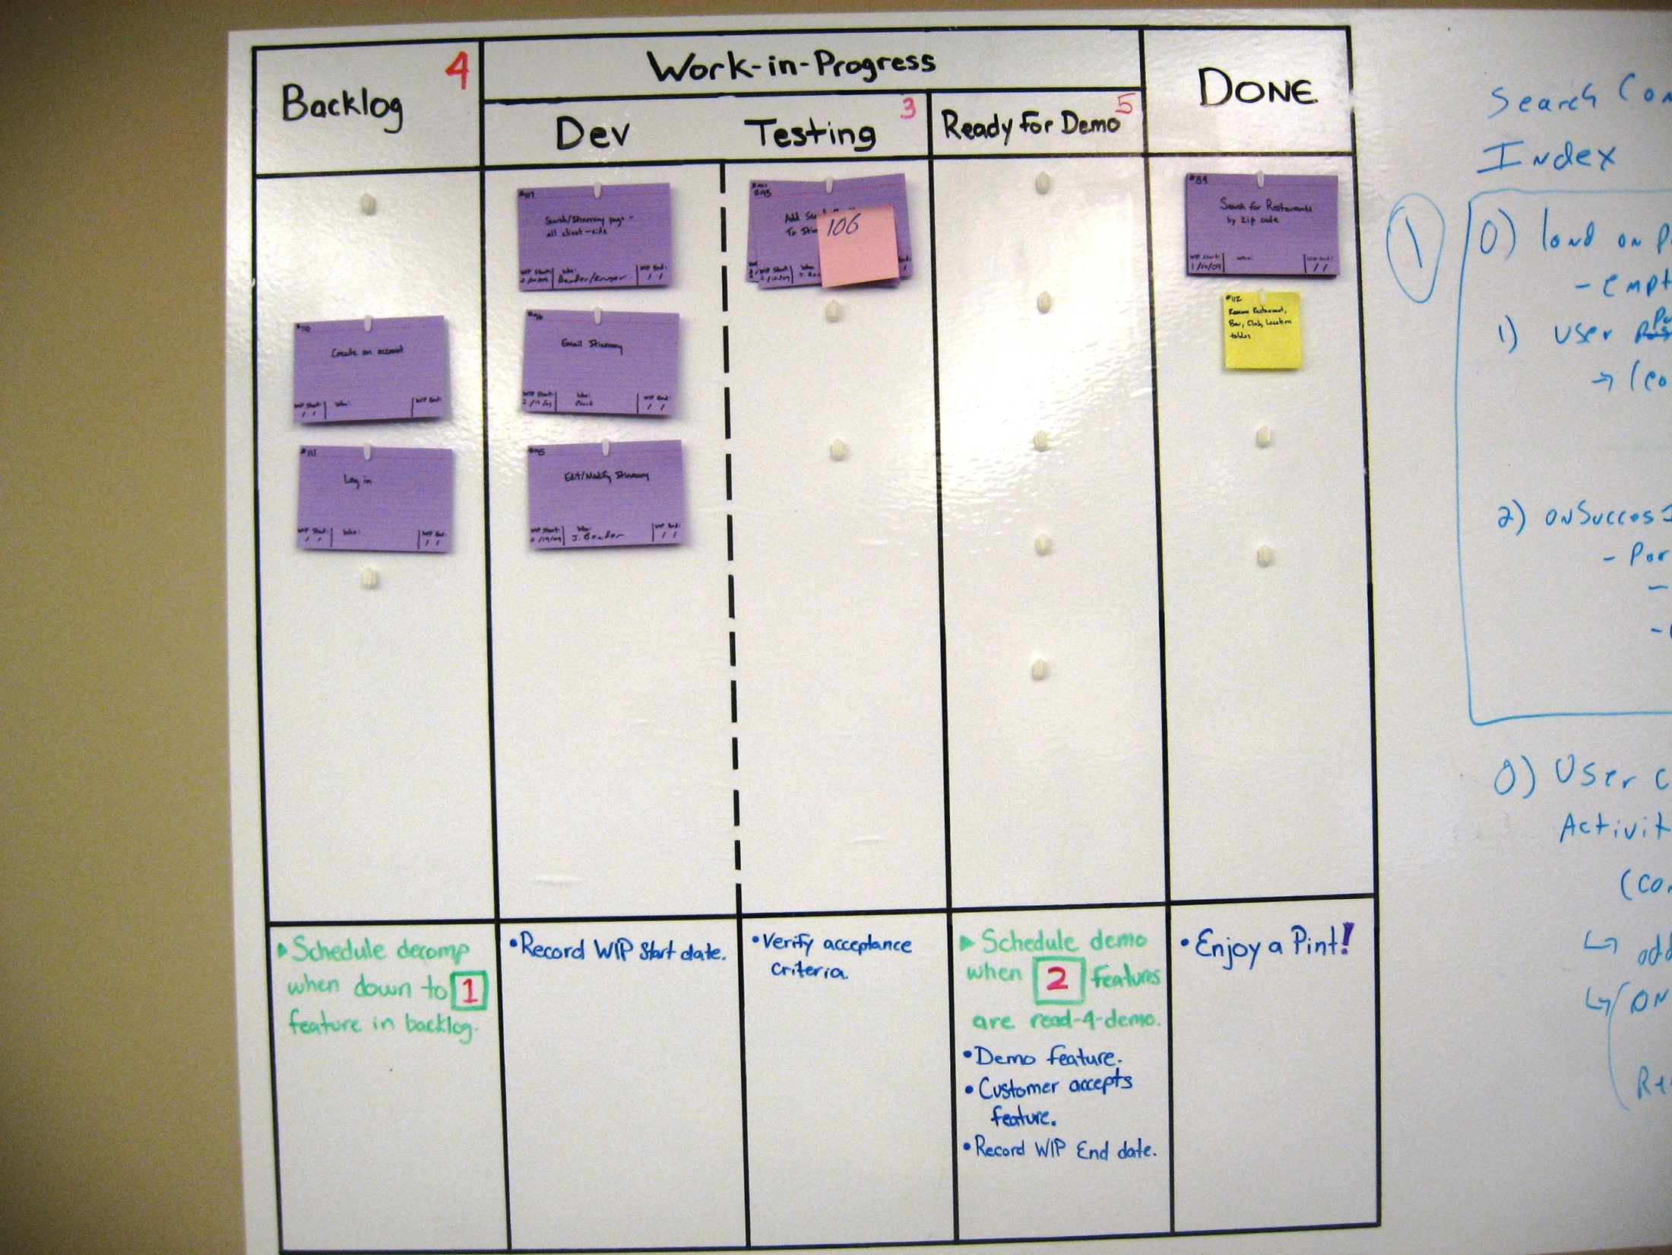
Notes:
MVC Project Sample Board

Slide 34
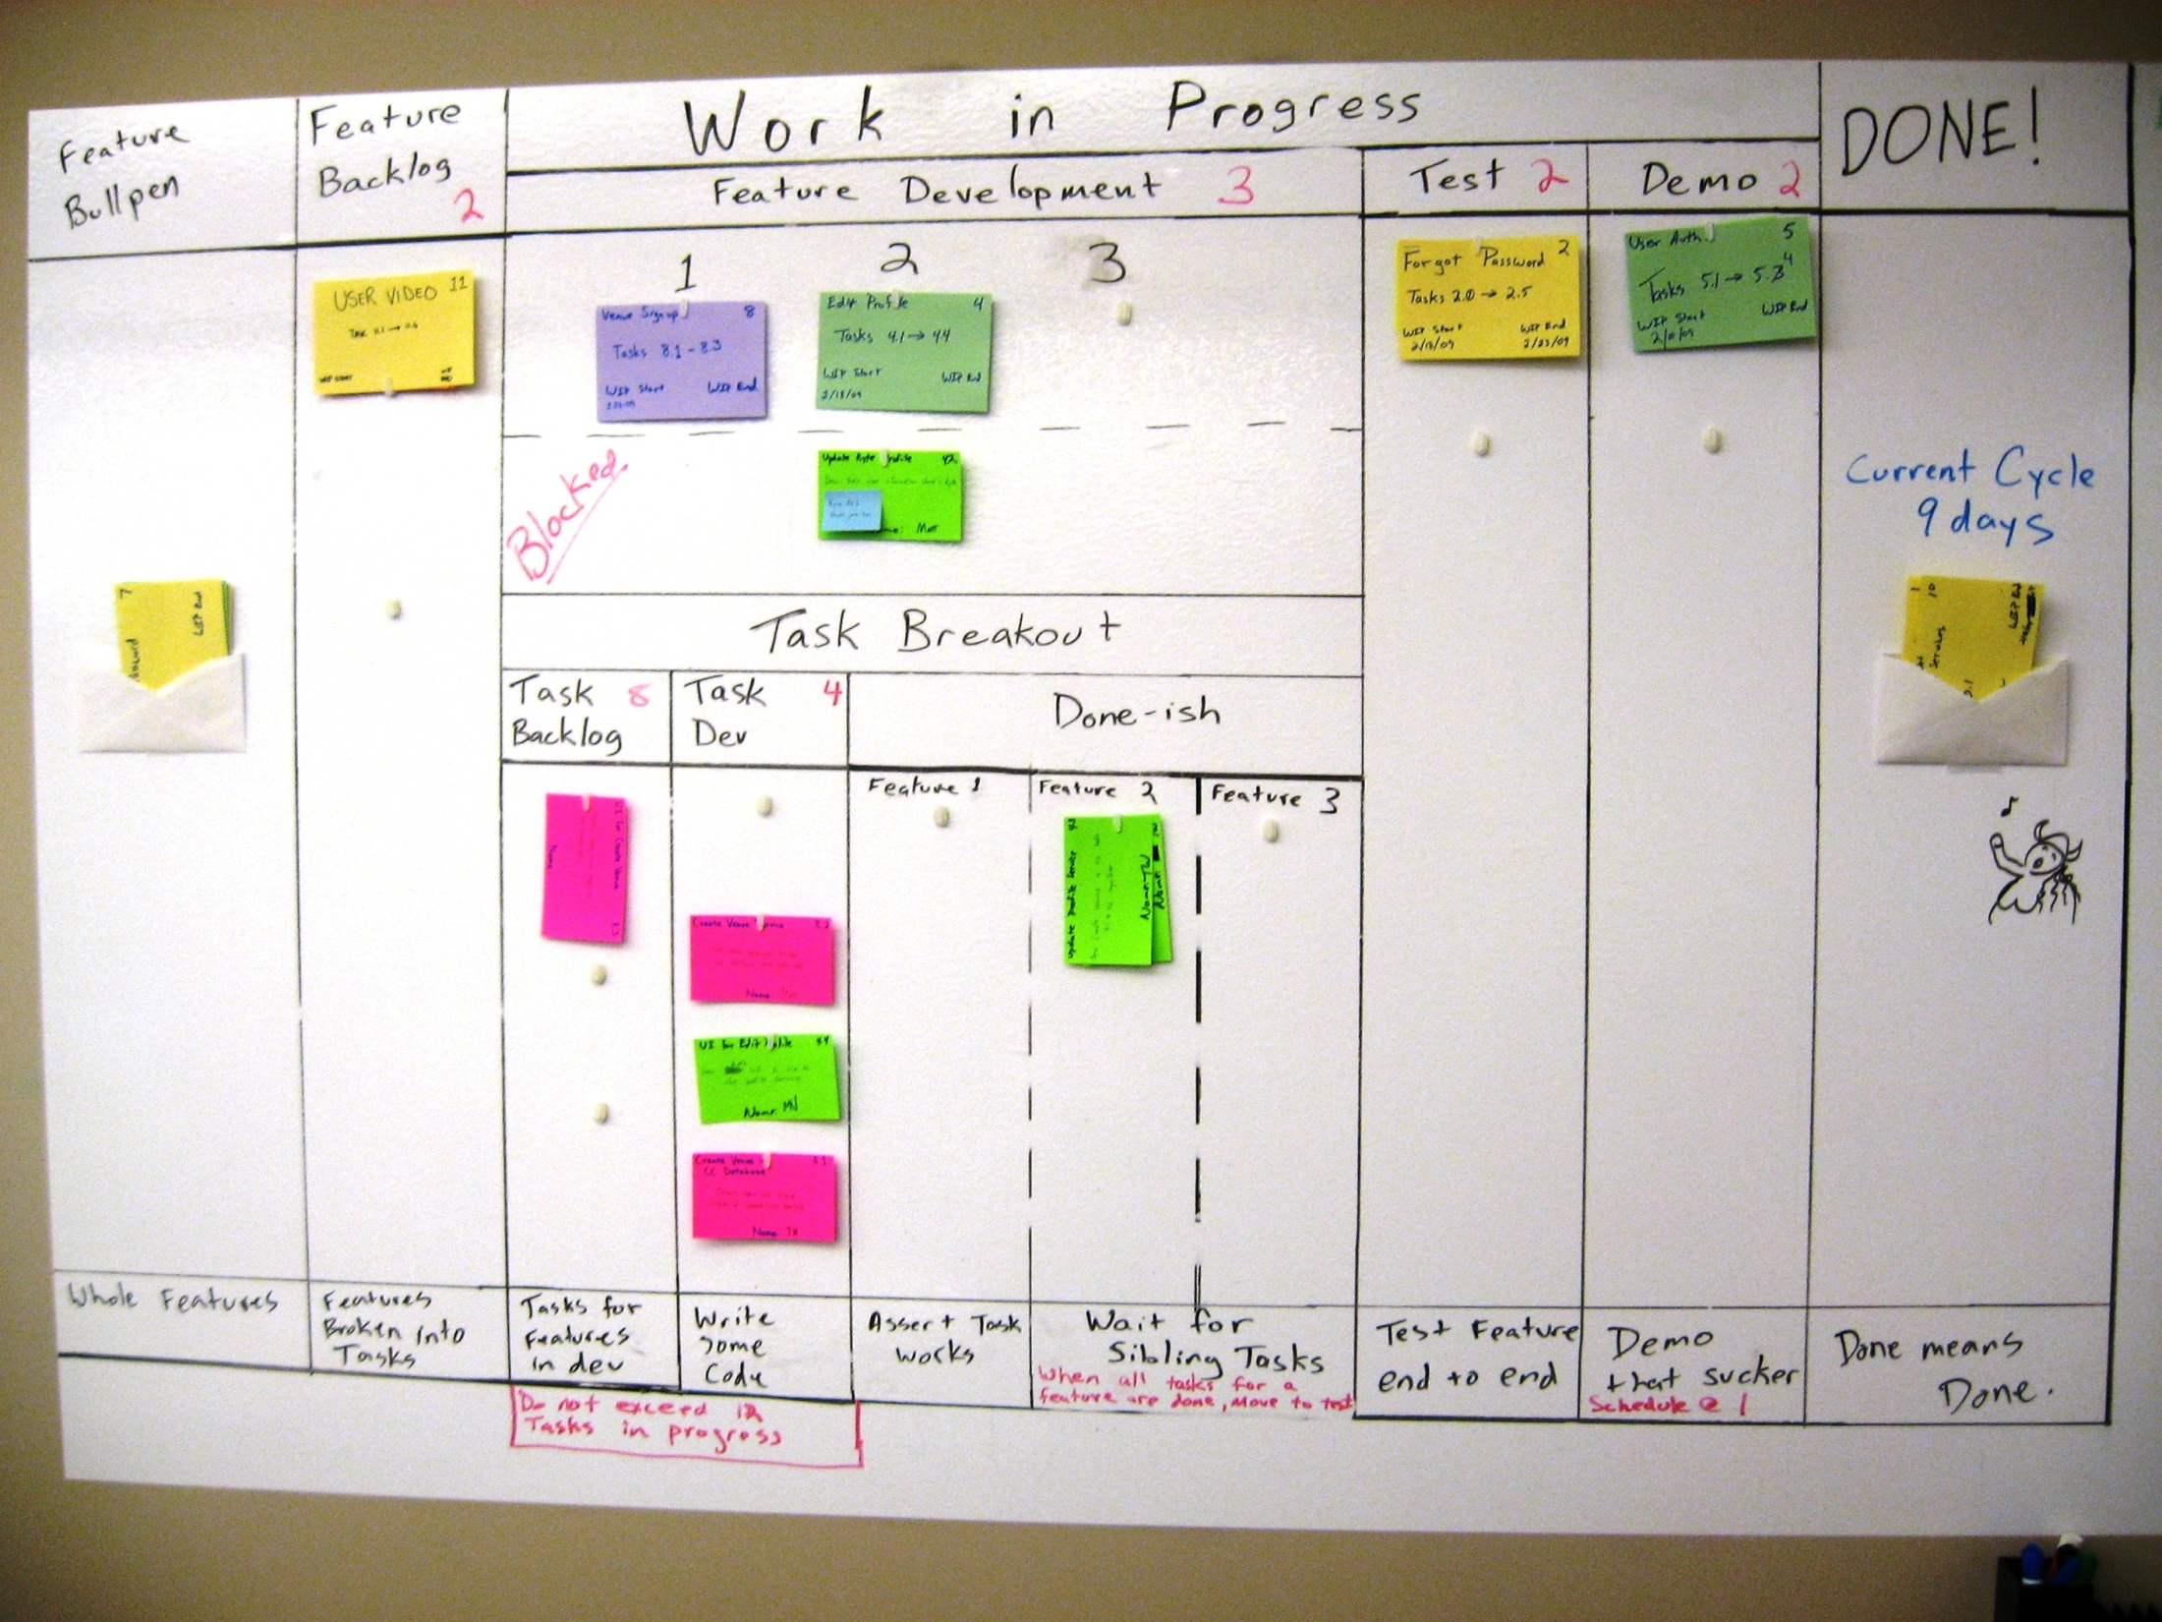
Notes:
Web Forms Project Sample Board

Slide 35
Benefits of Kanban
pptPlex Section Divider
The slides after this divider will be grouped into a section and given the label you type above. Feel free to move this slide to any position in the deck.

Slide 36

Notes:
Visualization
The Big Board
Similar to iteration sheets, it’s all right there in front of you
Works great for co-located teams. Distributed teams takes a bit more work…some tools are in development now.

Slide 37
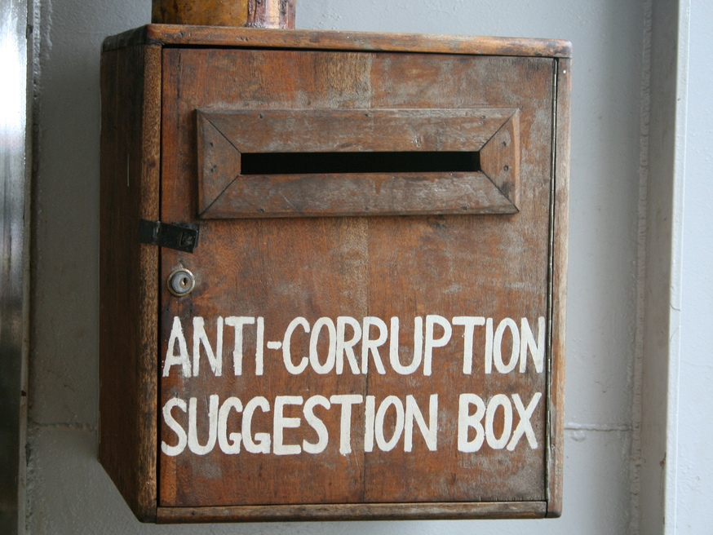
Tight feeback loop
Suggestion box
Notes:
Tight Feedback Loop
Testing done not long after dev is complete, quick feed back while task is still fresh with the developer
No waiting weeks at a time, or a whole iteration for feed back

Slide 38
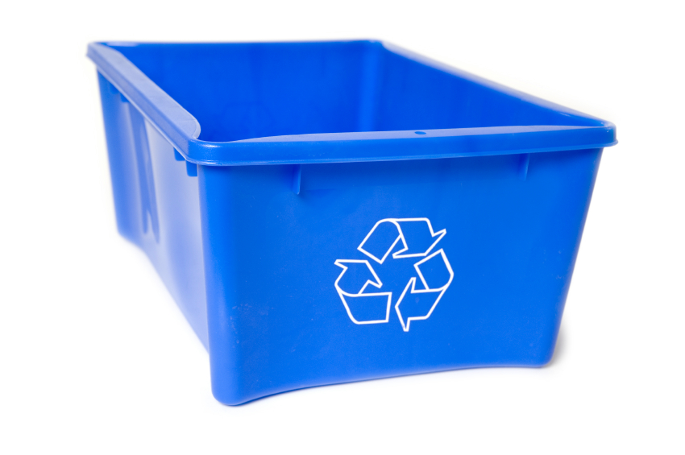
recycle bin
Notes:
Reduce waste
The quick feedback
The prioritization
The manageable backlog
Eliminate thrashing

Slide 39
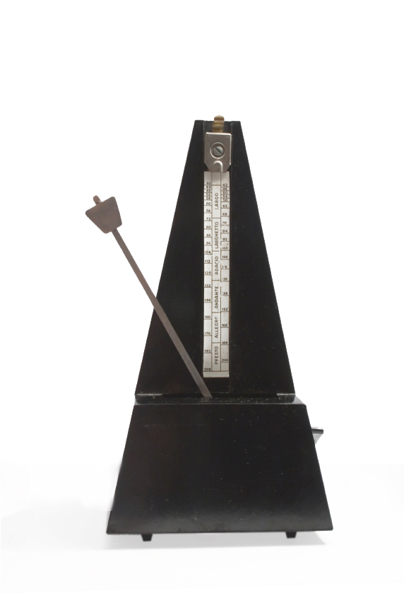
Notes:
Flow
Get a cadence
Gain momentum as tasks start to move (Cite RL example)

Slide 40

Notes:
Happy Team
Happy devs, they’re cranking out good work
Happy client, they’re getting more bang for the buck
Happy users, they’re getting features quickly and more often

